Slide 1
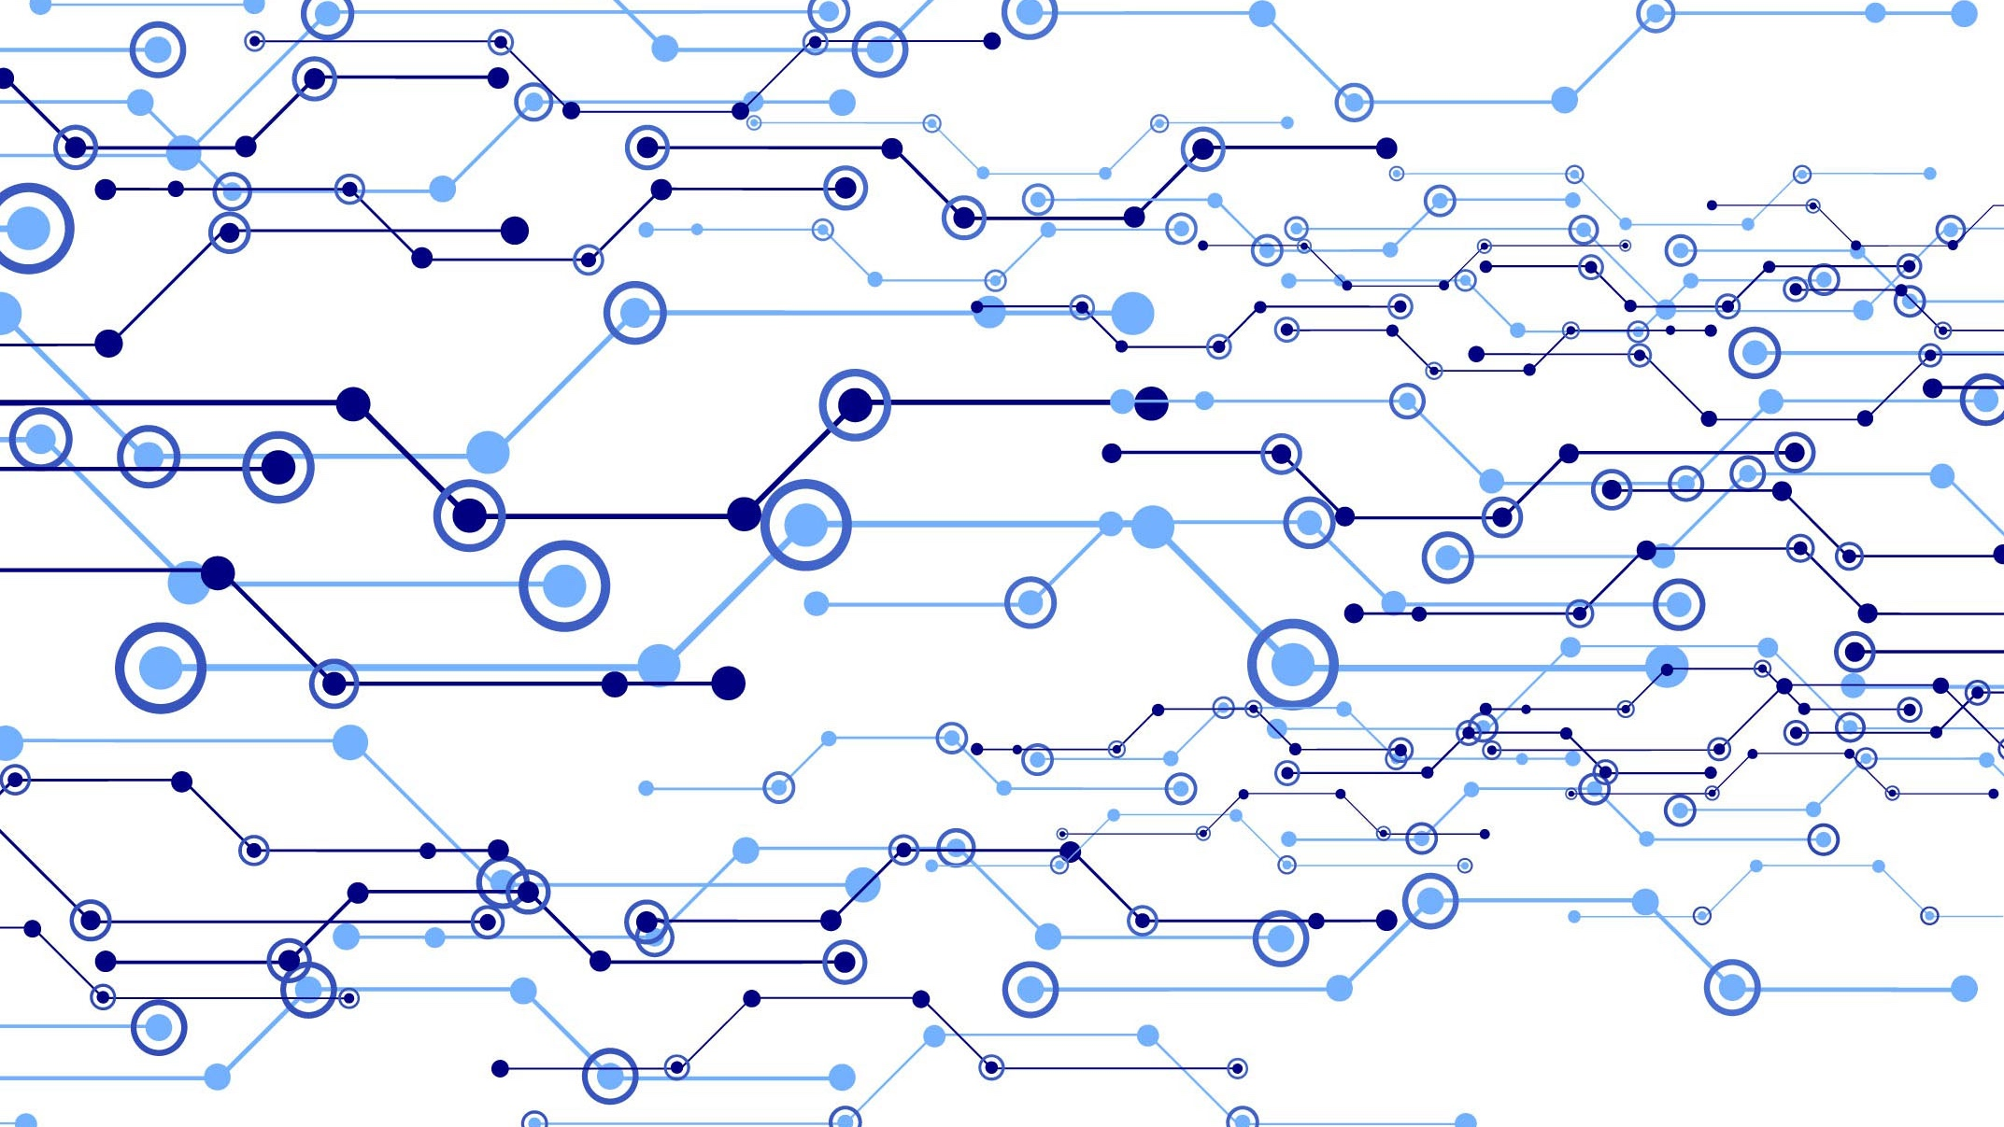
Smarter Way to Enter into Digital World
DS³

Slide 2
Hello!
I Am DS³
“I will secure your house and ensure the safety by notifying you” .

Slide 3

“
“Don’t find customers for your products, find product for your customers ”

Slide 4
OBJECTIVE
A
B
C
Our objective is to build an easy to install and low cost smart home security lock system with the function of RFID access. We aim to maximize security and optimize convenience in order to provide a safe and comfortable home security. With easy affordability and availability.
Security is a big challenge everywhere because thefts are increasing day by day owing to the unsafe and insecure security systems in homes, commercial complexes and industries.
So we have tried to ensure the home security through RFID module , voice recognition , face recognition, GSM module and immediate Gmail notification if not recognized an alarm will ring.

Slide 5
Target Users
People who want to maintain there home security in their absence and have a database of the person’s entering in the house.
In offices for the attendance system record.
In banks for the employs attendance.
In hospital ie., for ICU security etc.

Slide 6
Benefits
Cost efficient
Implementable
Immediate Notification
RF ID card has a unique number.
Face recognition make this system more secure
Protection through voice command.
Past data can be access by the owner

Slide 7
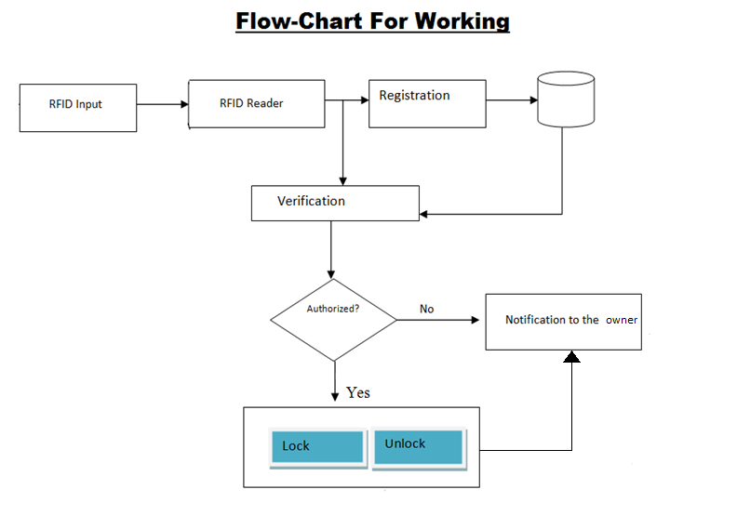

Slide 8
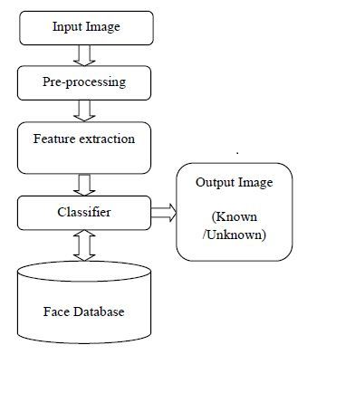
Processing of Face Recognition system

Slide 9
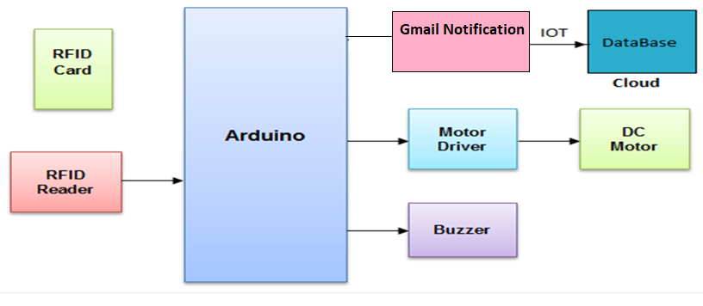
Tools Used

Slide 10
Future Improvisation
We can implement through our ATM card , in which we will use its encrypted data of its chip.
In place of Gmail notification we can notify through mobile sms , using GSM module .
And through an android app we can try to do the same process.
Use of the Biometric scanner.

Slide 11
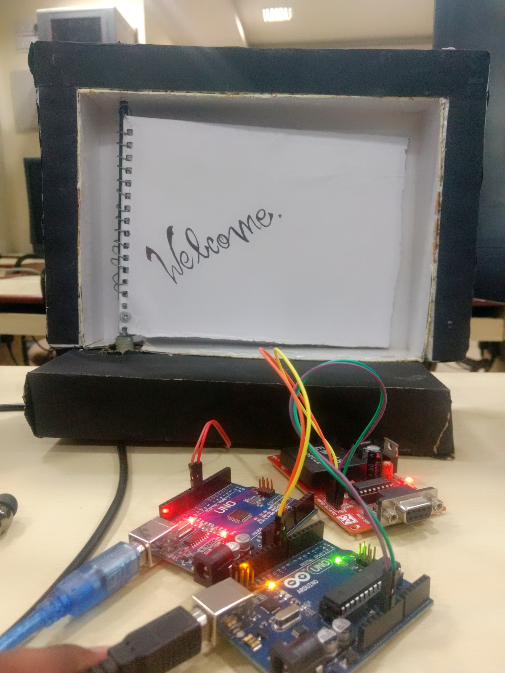
PRODUCT PICS

Slide 12
CONCLUSION
We investigated the security vulnerabilities on the smart home from examining smart lock by leveraging reverse engineering. We analyzed the security of the smart lock system comprehensively, and demonstrated attacks toward the system by exploiting the normal lock system. We then provided the corresponding defense suggestions for the smart lock. We proposed to provide security mechanisms for the smart home appliances in general at multiple levels to ensure the security of smart devices, including the RF ID system, voice recognisation and smart home appliance hardware. In future work, we plan to investigate other types of IOT devices, and develop a holistic security framework to secure the IoT systems.

Slide 13
Thanks!

